Slide 1
Problems

Slide 2
Question 1
You are provided an array A of size N that contains non-negative integers. Your task is to determine whether the number that is formed by selecting the last digit of all the N numbers is divisible by 3.
Note: View the sample explanation section for more clarification.
Input format
First line: A single integer N denoting the size of array
Second line: N space-separated integers.
Output format
If the number is divisible by 3, then print Yes. Otherwise, print No.

Slide 3
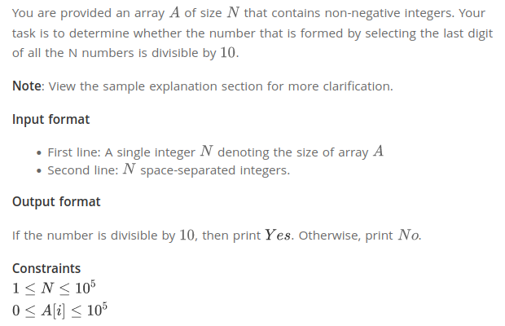
Original Question
https://www.hackerearth.com/practice/basic-programming/input-output/basics-of-input-output/practice-problems/algorithm/divisible-or-not-81b86ad7/

Slide 4
Hints (Ques 1)
let x = [85, 25, 65, 21, 84]
/* First Task: create the number
The number is: 55514
Formed by combining last digits of the input natural numbers.
*/
/*
Second Task: Check the divisibility of number formed in First Task by 3.
*/

